Slide 1
Tech sharing
@我是小山我是坏人
微信 handy-wang
2013.08.16

Slide 2
Topics
Video playback
SQLite optimization&migration
Refrences

Slide 3
Video playback
FFmpeg
UIWebView(<Object>|<Video>)
MPMoviePlayer(View)Controller
AV(Queue)Player

Slide 4
FFmpeg
FFmpeg is a complete, cross-platform solution to record, convert and stream audio and video.
Supports more video/audio formats

Slide 5

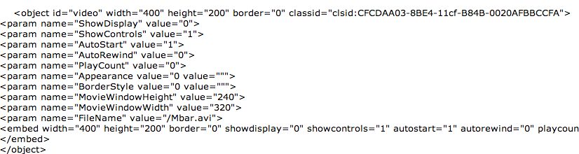
UIWebView
HTML5 <video> tag: mp4, ogg, webM/Methods& Properies
<Object>: avi, mpg, smi, rm……
Issue: Play local file
Deep learning: WebKit中HTML5 Video的实现分析

Slide 6
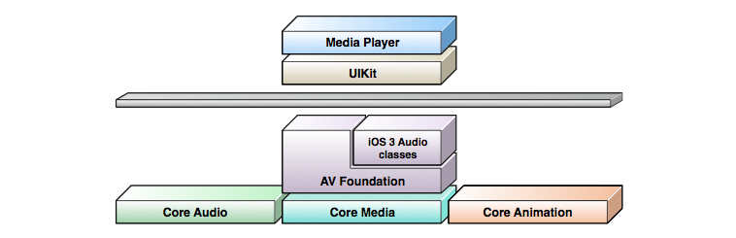
MPMoviePlayer(View)Controller
Supported formats
API
Issues

Slide 7
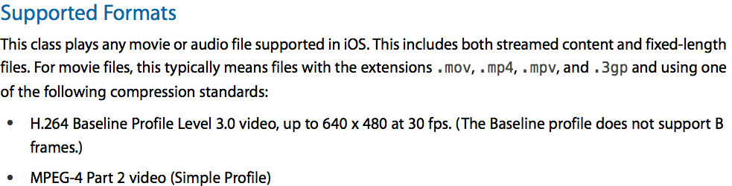
Supported formats

Slide 8
API
Demo
MediaPlayer.framework
Dev flow(load/render/play/observation)
State control/access/observation/others
  Play/Pause/Stop/Seek/FullScreen
  Rate/playbacktime/duration/state(playback|load)/fullscreen/thumbnail/logs
  Notification-based observation
  Credential
UIInterface synchronization

Slide 9
Issues
Only one playerLayer intance works.
How to play multi-videos
Tracking playbackTime?

Slide 10
AV(Queue)Player
Supported formats
API
Issues

Slide 11
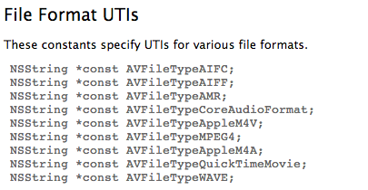
Supported formats

Slide 12
API
Demo
AVFoundation&CoreMedia.framework
Dev flow(load/check/render/observation/play)
  URL/Asset
  Track/playable
  AVPlayerItem/AVPlayer/AVPlayerLayer
  KVO Observations+Notification-based

Slide 13


Slide 14
Issues
Only one playerLayer intance works.
When did rate change: Play/Stop/ResignActive
Observe status of bad network while playing?
Paired Timer Observer
addBoundaryTimeObserverForTimes:queue:usingBlock:?
Create CMTime(frameSeq, FPS)

Slide 15
总结
从API上看三者是相通的
WV简单适用Web环境，但满足不了XH!
MV属高级API更简单易用，基本都能满足XH的BT UI!
AV更底层，对状态跟踪和控制麻烦一些，虽也可播放但偏向于音视频处理

Slide 16
FMDB-SQLite optimization&migration
SQLite Modes
Optimization
Migration

Slide 17
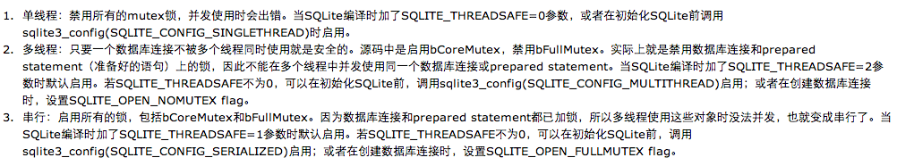
SQLite Modes

Slide 18
Optimization
S-M-FMDBQueue(WR)+WAL
WAL-Write-Ahead logging(3.7.0/iOS4.3)
Don’t Query massively firstly then update in Transaction
Replace into ⬄ update (select where)
Delete in ⬄ Delete where or
Select count(*) ⬄ select *

Slide 19
Migration
Why
How1 ➔How2
  Replace SQLite file
  Record & Playback
  Can be better?
Notes:
  Release all db instances(Blank bug)
  Integrity Check(Blank bug)

Slide 20
Refrences
FFMpeg:http://www.ffmpeg.org/
HTML5音视频参考手册
http://www.w3school.com.cn/html5/html5_ref_audio_video_dom.asp
WebKit中HTML5 Video的实现分析
http://blog.csdn.net/horkychen/article/details/7855814
MPMoviePlayerController_Class.pdf
AVFoundationPG.pdf
AV Foundation Constants Refrences
SQLite优化总结:
http://handy-wang.iteye.com/admin/blogs/1748140
Sqlite在多线程下的应用:
http://www.cnblogs.com/wuhenke/archive/2011/11/20/2256618.html
SQLite完整性检查
http://www.sqlite.org/pragma.html#pragma_integrity_check

Slide 21
Thanks for
Practice and sharing
To be continue…

